Slide 1
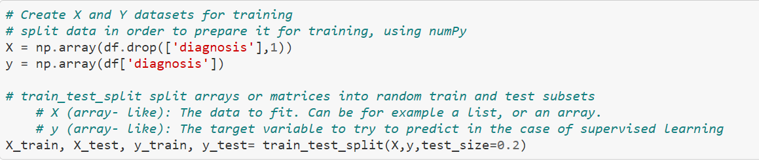
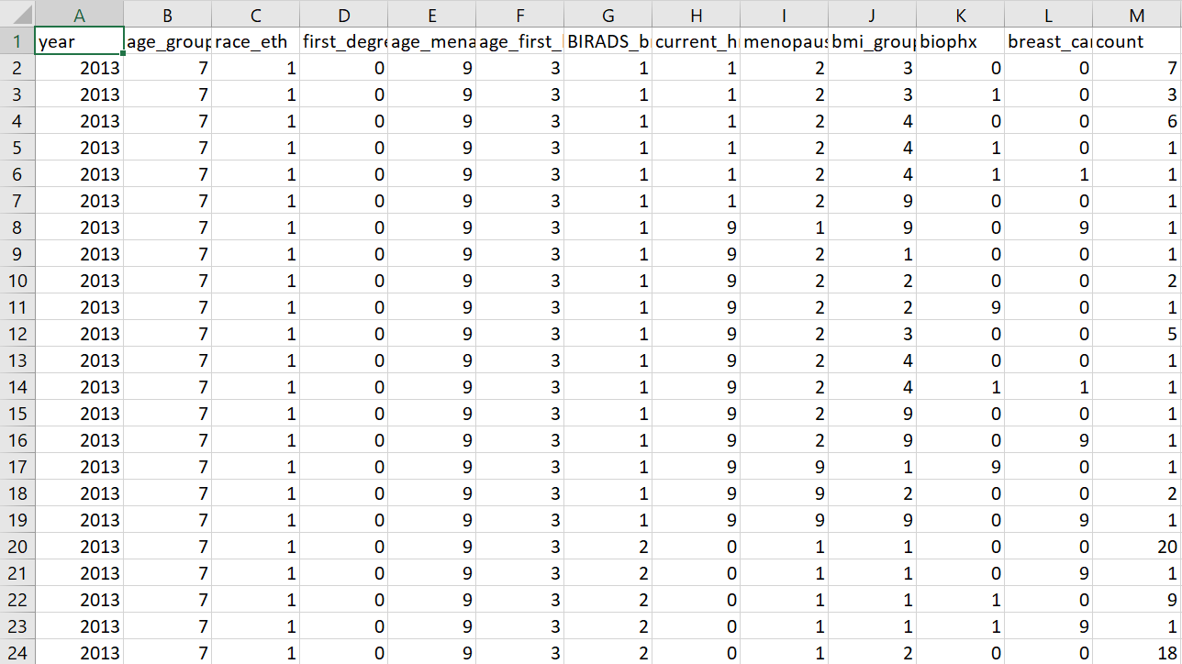

Breast Cancer Factors
by Rosadas Tigers
We use these predictions and modeling to spread awareness
This data set has breast cancer risk factors models in categories such as age, ethnicity, weight, etc.
We take these models to create predictions
The predictions allow use to relate the factors to the cause
https://github.com/mahnoorbaig/breast-cancer-prediction/blob/master/Breast%20Cancer%20Classification.ipynb

